Slide 1
Distributed system project
NCCU Executive Master of Computer Science
Directed by Prof. Hu Yu Chung
2018.10.16
Joseph Lin

Slide 2
Agenda
Install Spark on Ubuntu
GDELT
Graphframe
Demo
Advanced Project Plan

Slide 3
Install Spark on Ubuntu
參考附件
Checking python version
Install python3-pip (to install jupyter afterward)
Install jupyter
Enable jupyter notebook
Update apt-get
Install java
Install py4j
Install spark and hadoop
Put/Unzip spark file under your home folder
Tell python where actually find spark (link pyspark and jupyter notebook)
Checking permissions on the spark folder
Setting up pyspark (you can import pyspark not only in the spark directory using findspark)

Slide 4
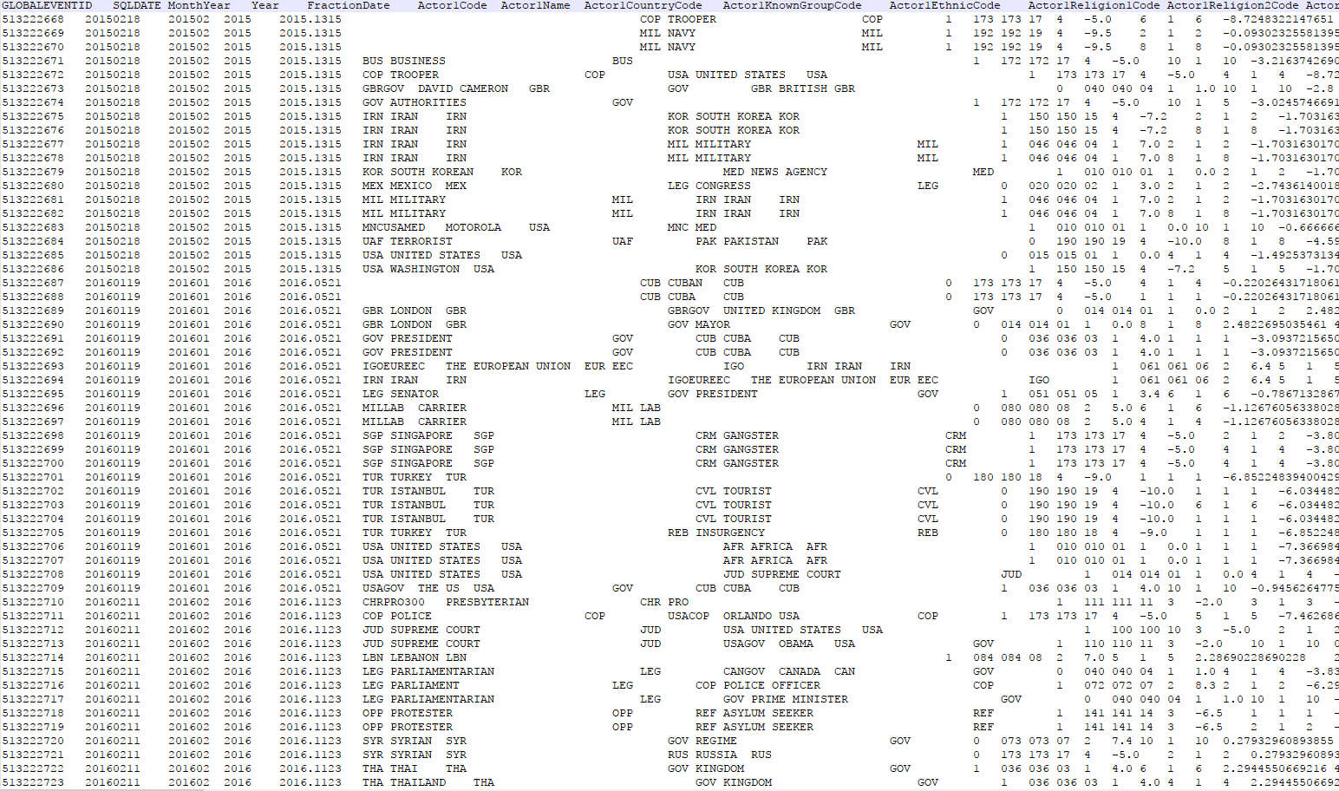

GDELT

Slide 5
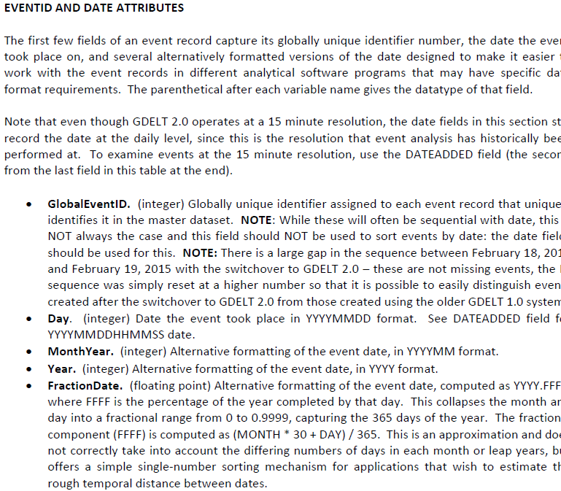
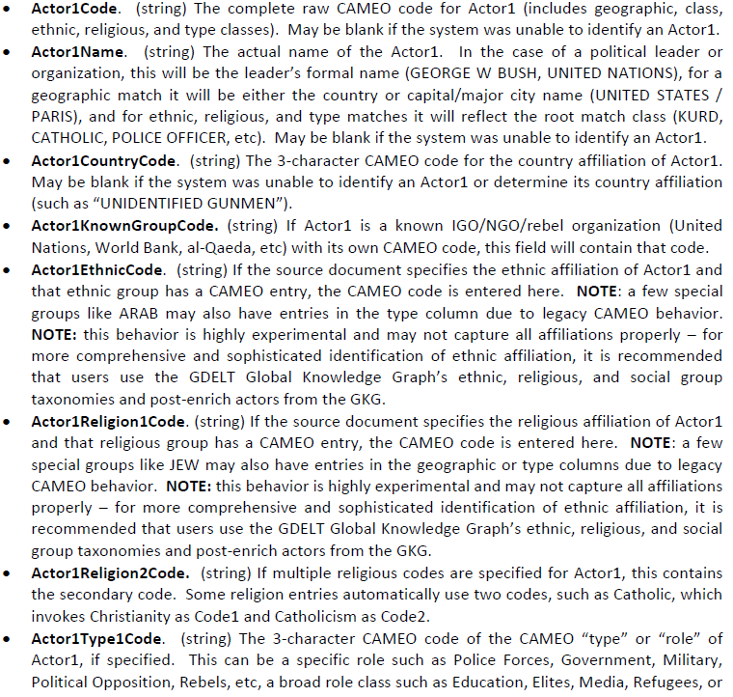
GDELT
GDELT-Event_Codebook-V2.0.pdf
GDELT Event Codebook說明各欄位屬性

Slide 6
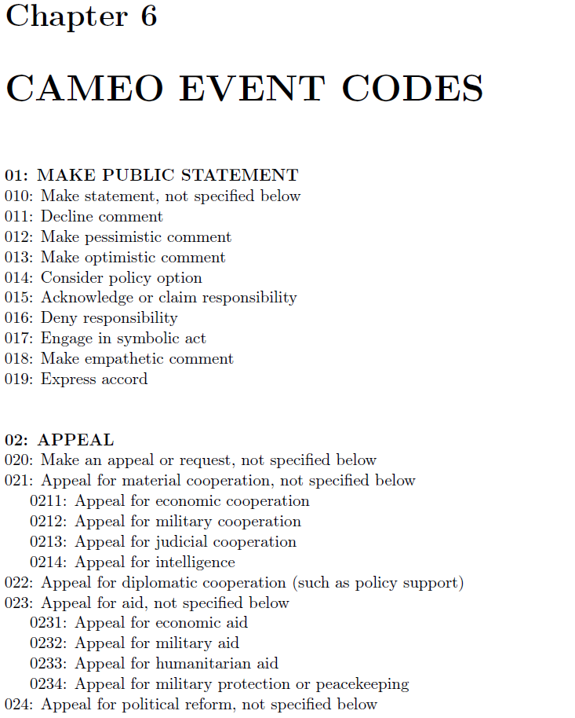
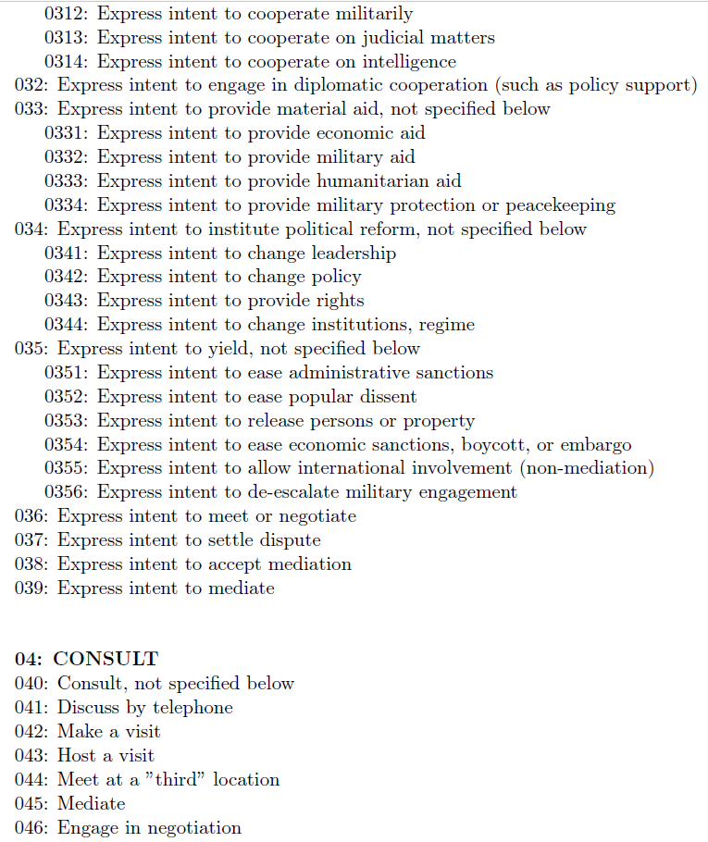
GDELT
CAMEO Event Code說明Event Code意義
CAMEO.Manual.1.1b3.pdf

Slide 7
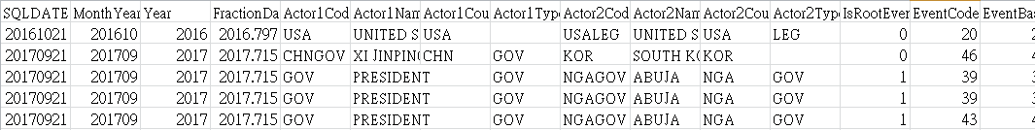
GDELT
Actor1:XI JING PING
Actor2:SOUTH KOREA
EVENTCODE:039 (Engage in negotiation)
每一筆GDELT資料,代表一篇新聞經過CAMEO分析後,濃縮為
Actor1 , 對 Actor2, 發生了 Event Code事件
例如:
習近平對南韓達成協議共識

Slide 8
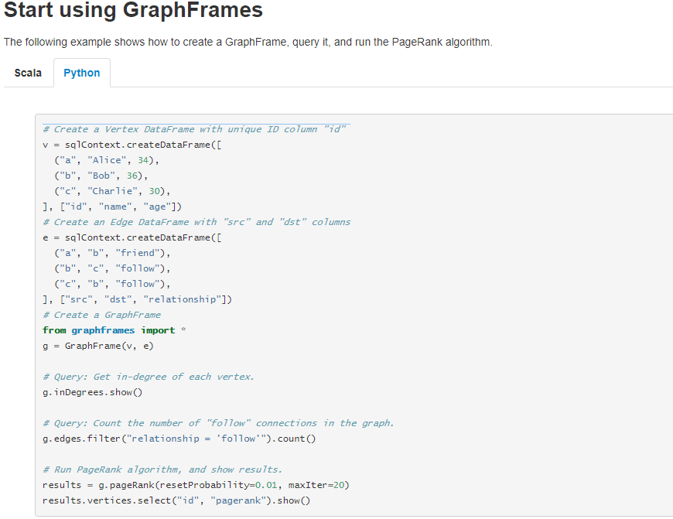
GraphFrame
GraphFrame需要兩個DataFrame, 分別代表
Vertex ( id, 屬性…)
Edge ( 來源, 目的, 關係)
https://graphframes.github.io/quick-start.html

Slide 9
Import GraphFrame
Run this cmd first
./spark-shell --packages graphframes:graphframes:0.5.0-spark2.1-s_2.11
Put the code below in your python program
#import spark with graphframes
spark = SparkSession.builder.appName('gdelt_1').config("spark.jars.packages", "graphframes:graphframes:0.5.0-spark2.1-s_2.11").getOrCreate()

Slide 10
GraphFrame Python
Related web info.
https://graphframes.github.io/quick-start.html
https://docs.databricks.com/spark/latest/graph-analysis/graphframes/user-guide-python.html
https://databricks.com/blog/2015/08/12/from-pandas-to-apache-sparks-dataframe.html
https://github.com/graphframes/graphframes/blob/master/docs/user-guide.md
Official API
https://graphframes.github.io/api/python/index.html

Slide 11
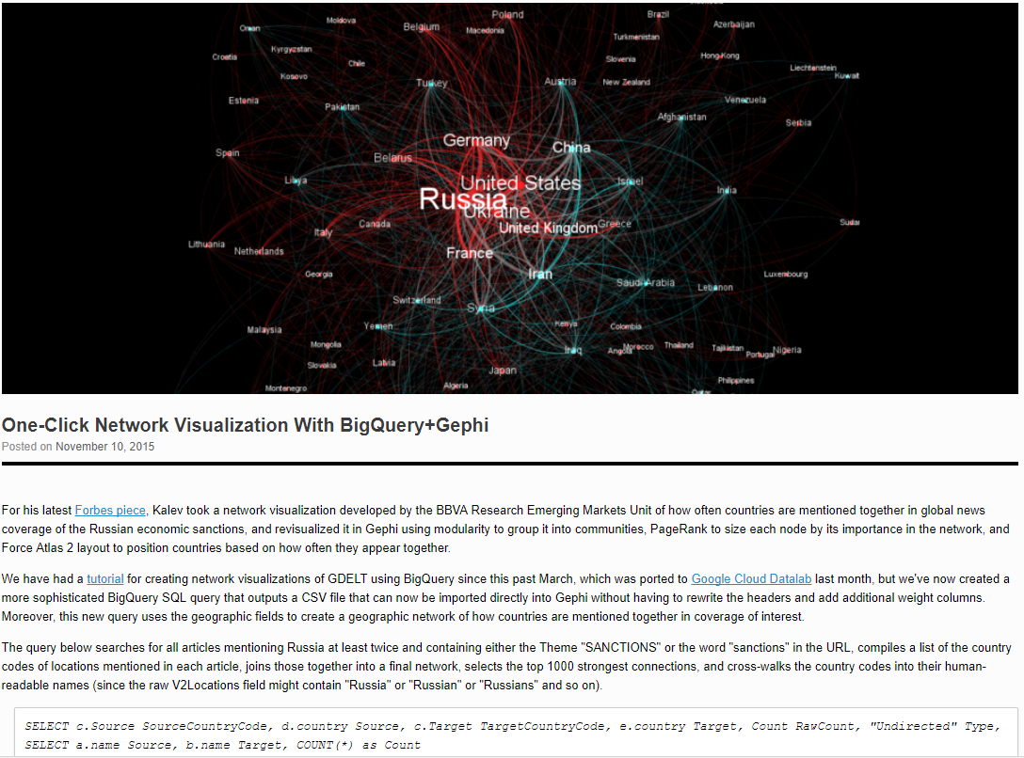
Before Implement
GDELT的Graph分析應該長什麼樣子? 這張圖給了初步概念…
但是GDELT的資料要怎麼轉換成連結圖呢?
https://blog.gdeltproject.org/one-click-network-visualization-with-bigquerygephi/

Slide 12
Before Implement
Image what GDELT Graph Analysis looks like…
最終我們給了GDELT資料集的Graph分析定義
Vertex = (Actor ID, ActorAttribute1, ActorAttribute2…)
Edge = (Actor1Attribute, Actor2Attribute, EventCode)
以Actor Country Code當作Vertex(分析對象),一筆GDELT資料可表達一條連結
例如: Actor1CountryCode (CHN)對Actor2CountryCode(USA)發生了某個EventCode
CHN
Event
USA
Event
Event
JAP
Event
IRA
KOR

Slide 13
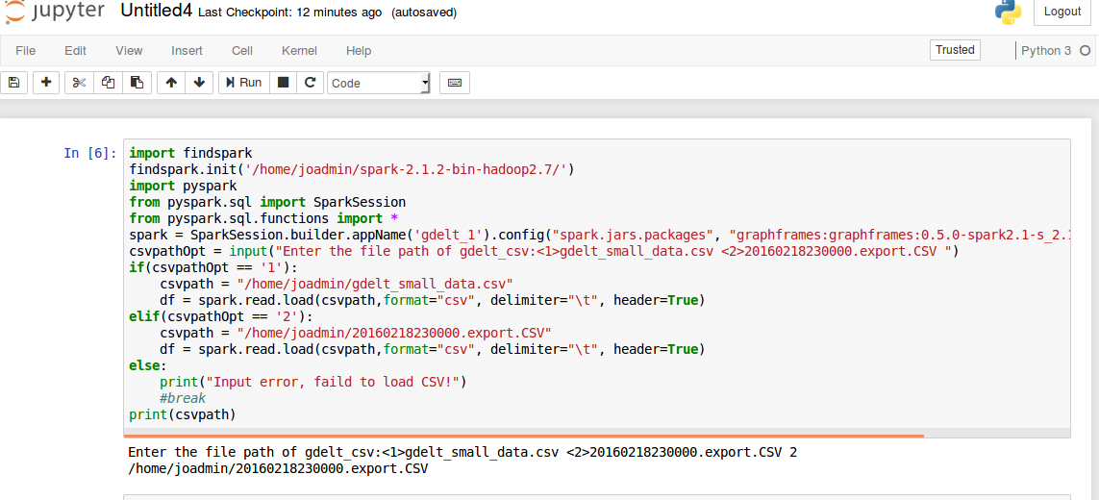
Demo-20160218230000.export.CSV
使用findspark套件啟用pyspark
設定匯入GraphFrames套件
使用簡單的互動輸入,決定要匯入的CSV

Slide 14
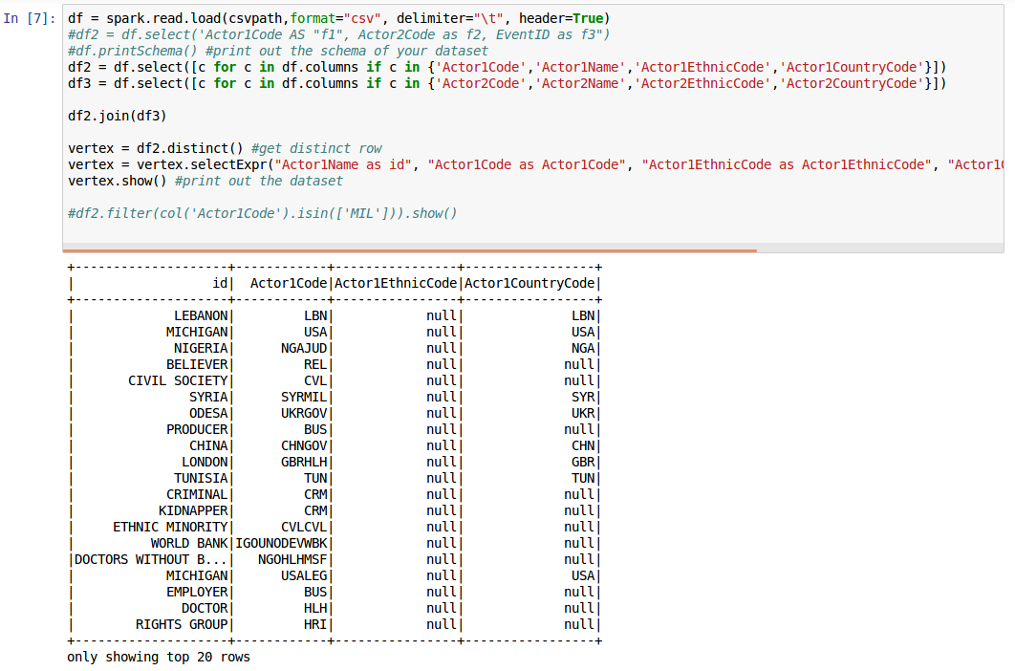
Demo-20160218230000.export.CSV
讀取要讀入的CSV
選取需要的Actor欄位,合併Actor1及Actor2
合併後取distinct(單一值)當作vertex

Slide 15
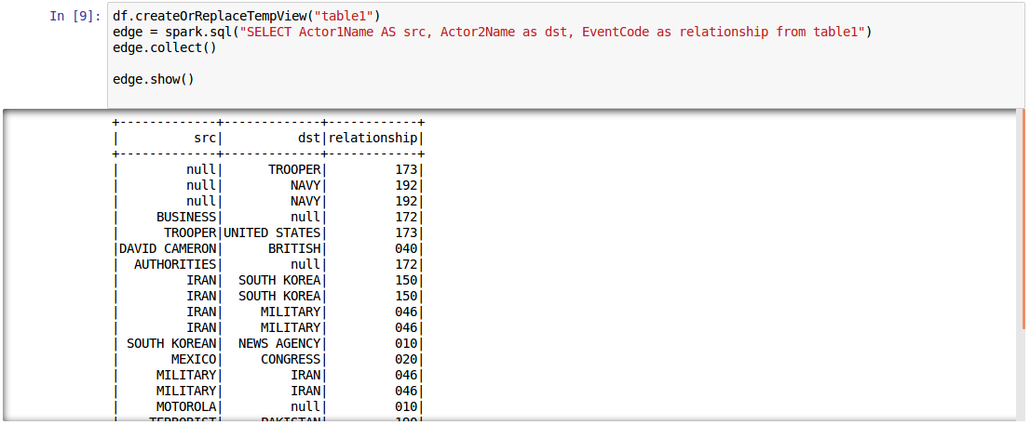
Demo-20160218230000.export.CSV
Map
Reduce
選取Source = Actor1Name
選取Destination = Actor2Name
選取Relation = EventCode

Slide 16
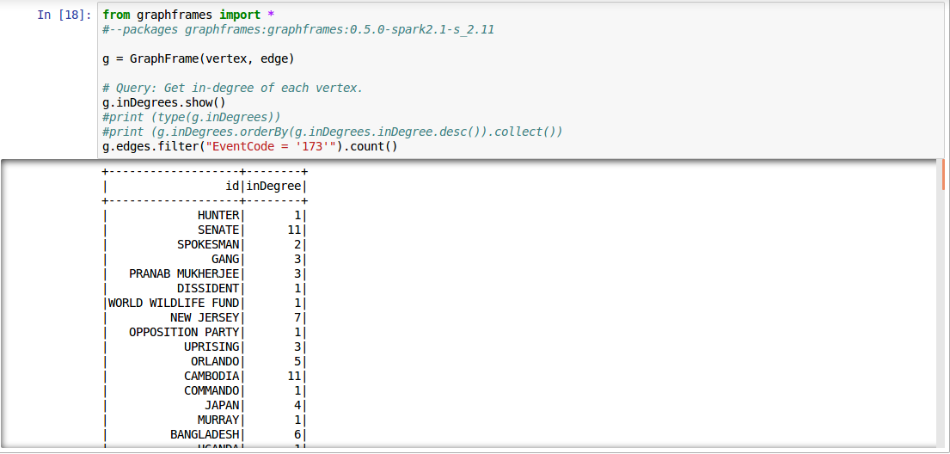
Demo-20160218230000.export.CSV
顯示in-degree
顯示EventCode = 173 的關係(事件)數量

Slide 17
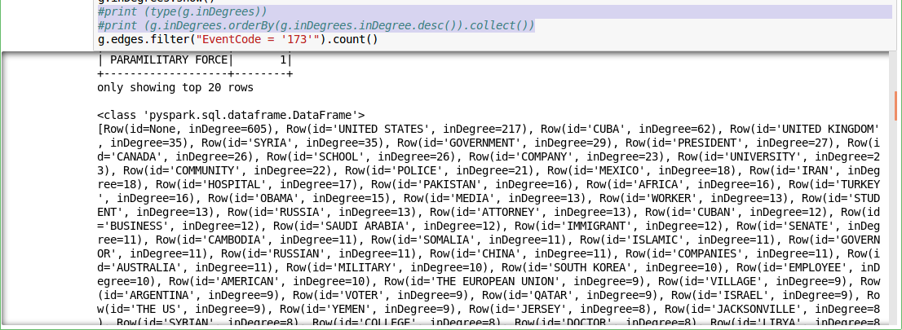
Demo-20160218230000.export.CSV
顯示in-Degree的datatype
#print (type(g.inDegrees))
#print (g.inDegrees.orderBy(g.inDegrees.inDegree.desc()).collect())
顯示排序後的in-Degree,
orderBy及 .collect()是Spark SQL 執行RDD Translation範例

Slide 18
Spark SQL
Related web info.
How to select the column you want
http://spark.apache.org/docs/2.1.0/api/python/pyspark.sql.html
How to filter value
https://stackoverflow.com/questions/33747834/sparksql-filtering-selecting-with-where-clause-with-multiple-conditions
Official API
https://spark.apache.org/docs/latest/sql-programming-guide.html#datasets-and-dataframes

Slide 19
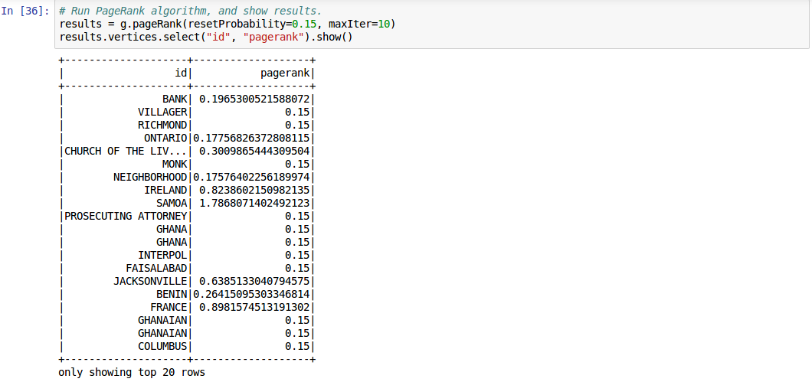
Demo-20160218230000.export.CSV
顯示Page Rank

Slide 20
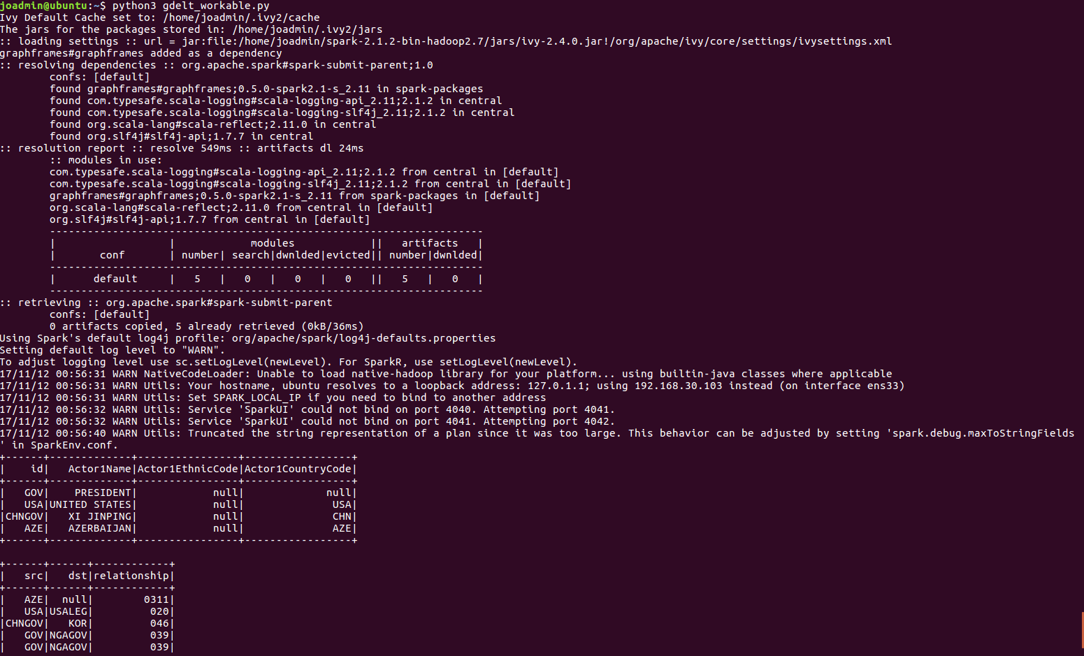
Demo-gdelt_small_data
使用python直接執行程式

Slide 21
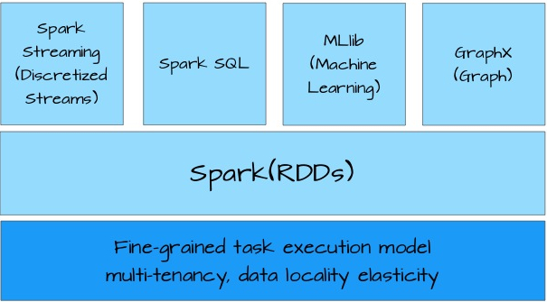
Requirement fulfillment
Requirement | Fulfillment
Using Github version control | -
Using public cloud | -
GDELT Dataset | 100%
Batch / Interactive analysis | 100% / ?%
Map Reduce / Graph network analysis | 100% / 100%
Task List
Streaming analysis
GCP spark deployment
Github
http://blog.kevinlinul.idv.tw/?p=369

Slide 22
後續延伸應用-金價波動預測
金價波動因素
黃金供給與需求
美元
油價
戰爭與政經
其他貴金屬價格
季節性變動
Actor Name = MIL
Event Code = 13X (Threaten)

Slide 23
後續延伸應用-搭配Markov分析
投資原則
買低賣高
耐心持股減少交易
Vertex could be: Actor1Name, Actor1EthnicCode, Actor1CountryCode…
Relation = Eventcode
統計分析不同屬性, 不同Event的Page Rank異動幅度與金價異動幅度的關係
我們不須預測每日的漲跌,只要可預測漲跌>5%, 10%...的事件

Slide 24
Q & A

Slide 25
Attachment
Install Spark on Ubuntu

Slide 26
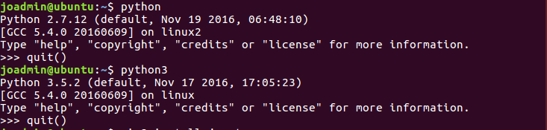
Install Spark on Ubuntu
Checking python version

Slide 27
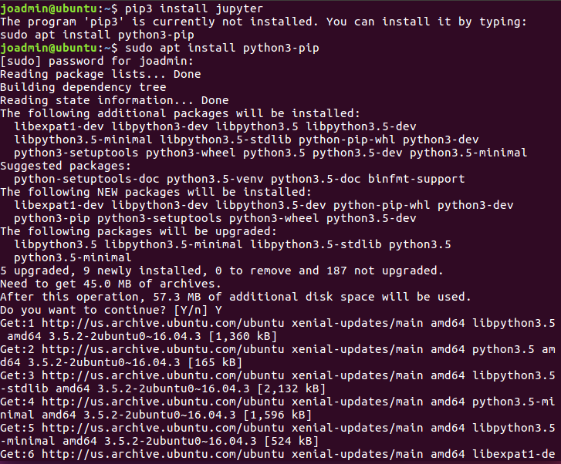
Install Spark on Ubuntu
Install python3-pip (to install jupyter afterward)

Slide 28
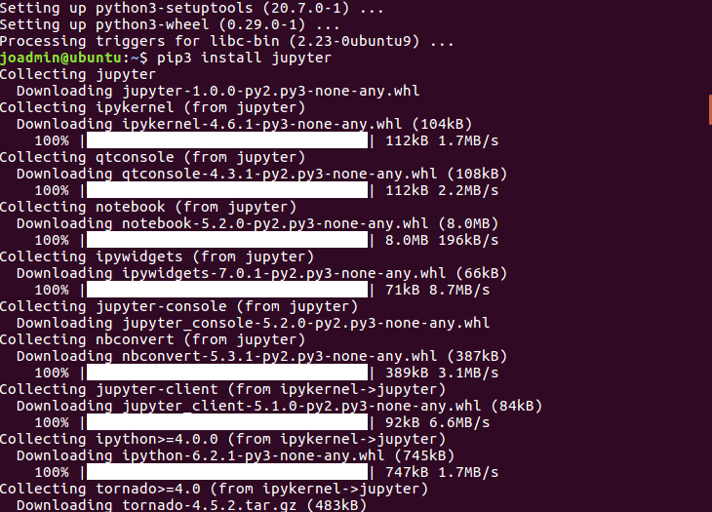
Install Spark on Ubuntu
Install jupyter

Slide 29
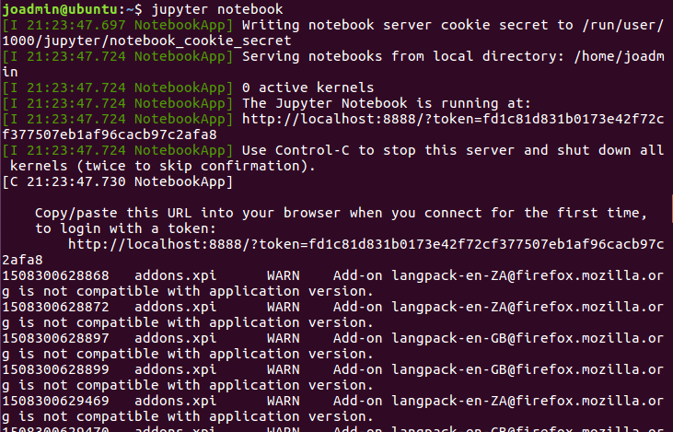
Install Spark on Ubuntu
Enable jupyter notebook

Slide 30
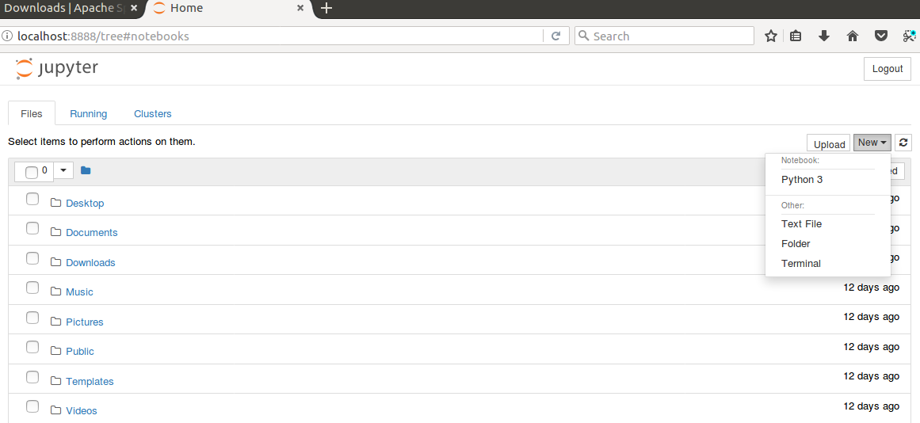
Install Spark on Ubuntu
Enable jupyter notebook

Slide 31
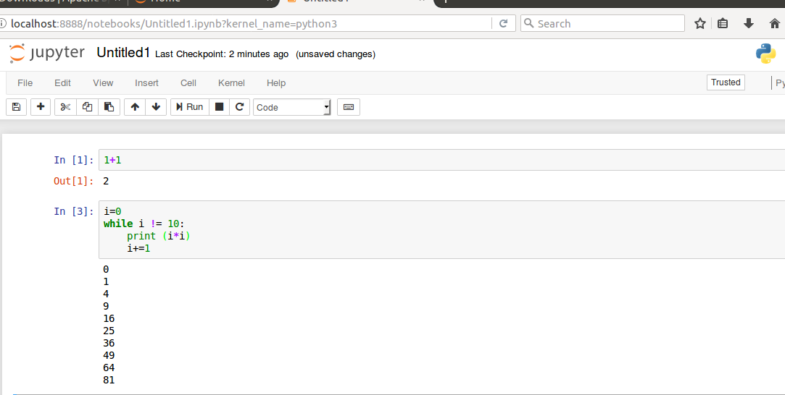
Install Spark on Ubuntu
Enable jupyter notebook (Checking)
Press shift+enter to compile and run

Slide 32
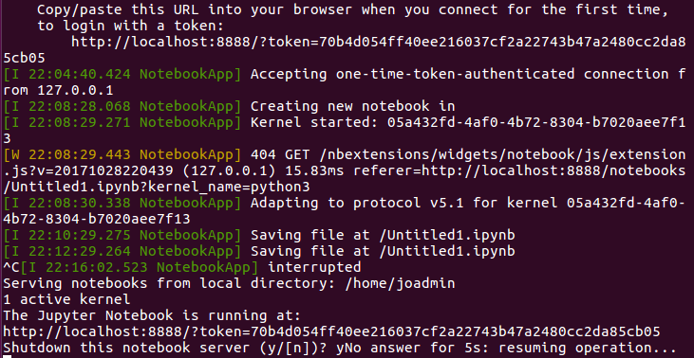
Install Spark on Ubuntu
Shutdown jupyter (optional)
Return to the terminal and press ctrl+c

Slide 33
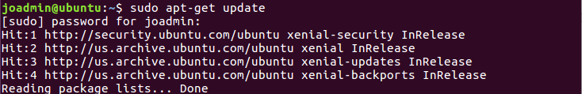
Install Spark on Ubuntu
Update apt-get

Slide 34
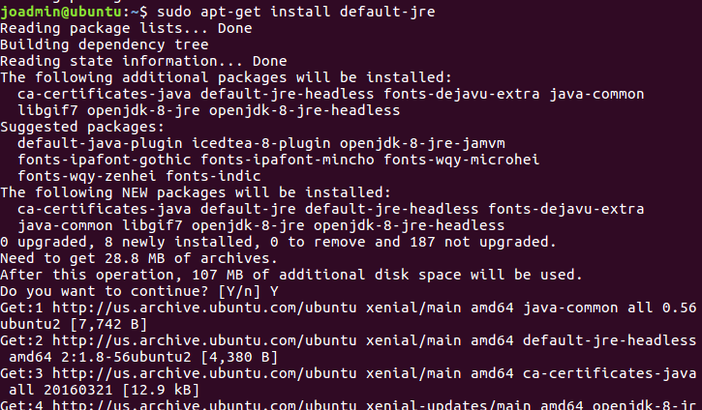
Install Spark on Ubuntu
Install java

Slide 35
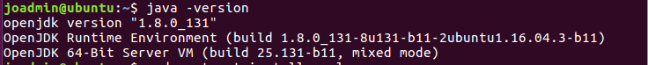
Install Spark on Ubuntu
Check java version (optional)

Slide 36
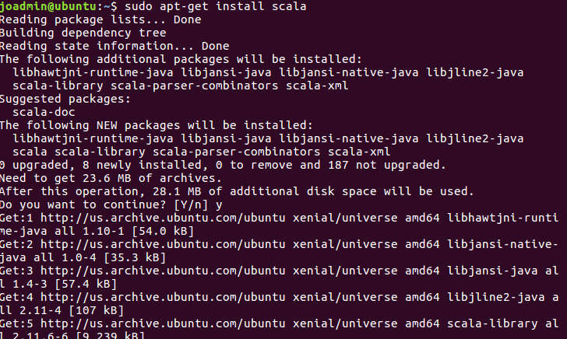
Install Spark on Ubuntu
Install scala

Slide 37
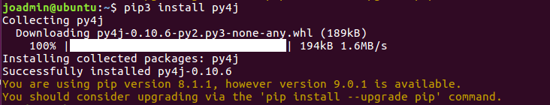
Install Spark on Ubuntu
Install py4j

Slide 38
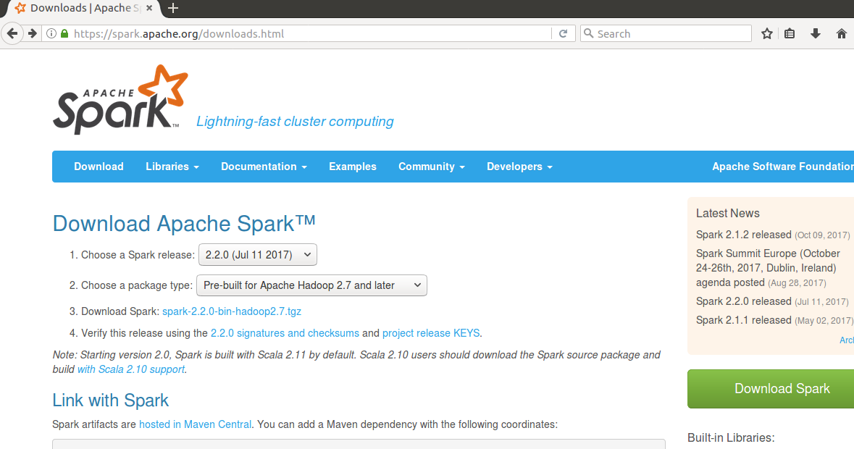
Install Spark on Ubuntu
Install spark and hadoop

Slide 39
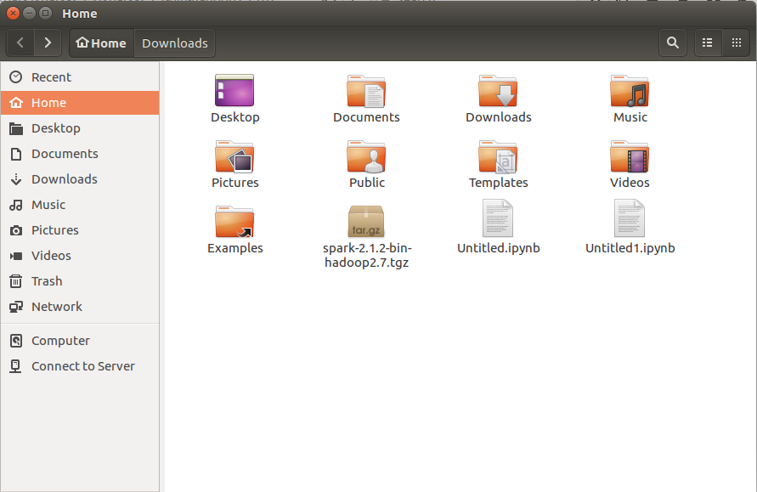
Install Spark on Ubuntu
Put spark file under your home folder

Slide 40
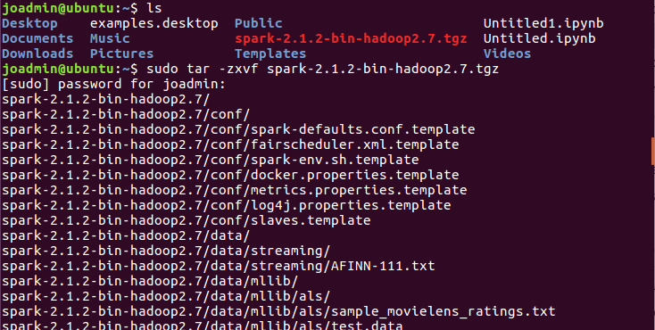
Install Spark on Ubuntu
Unzip spark installation file

Slide 41
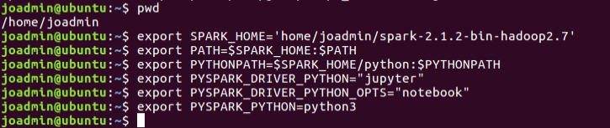
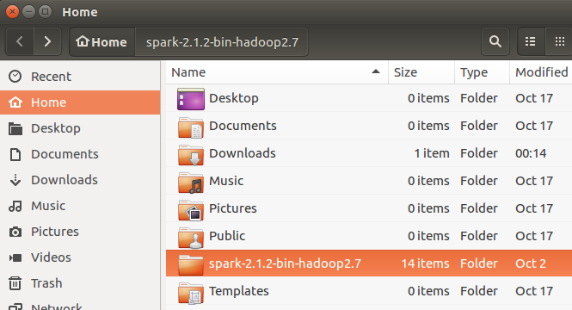
Install Spark on Ubuntu
Tell python where actually find spark (link pyspark and jupyter notebook)

Slide 42
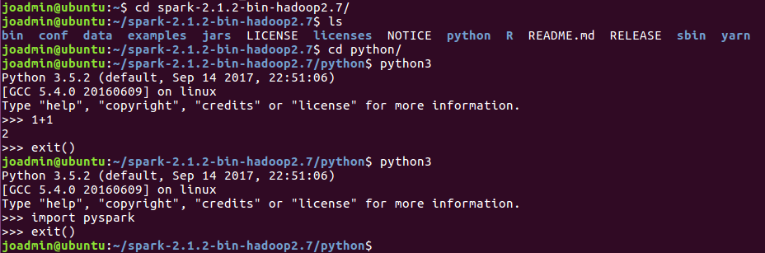
Install Spark on Ubuntu
Checking permissions on the spark folder

Slide 43
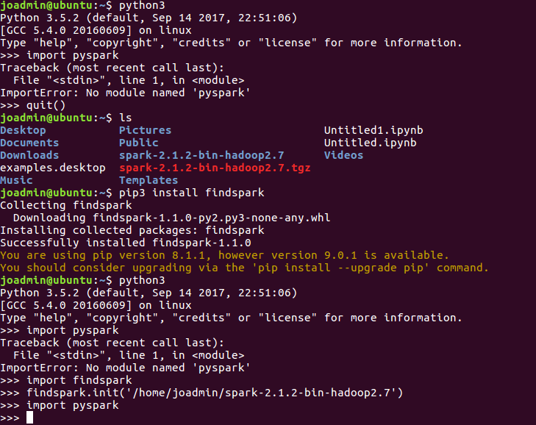
Install Spark on Ubuntu
Setting up pyspark (you can import pyspark not only in the spark directory)

Slide 44
Attachment
Related reference link

Slide 45
GDELT PageRank
https://www.forbes.com/sites/kalevleetaru/2015/11/12/whos-connected-to-whom-in-the-global-media/#7d9496a0921b
https://blog.gdeltproject.org/one-click-network-visualization-with-bigquerygephi/
https://www.forbes.com/sites/kalevleetaru/2017/02/27/creating-a-massive-network-visualization-of-the-global-news-landscape-who-links-to-whom/#2f36bea03a70

Slide 46
GDELT data import python
http://nbviewer.jupyter.org/github/JamesPHoughton/Published_Blog_Scripts/blob/master/GDELT%20Wrangler%20-%20Clean.ipynb
https://pypi.python.org/pypi/gdelt

Slide 47
pyspark map reduce example
https://spark.apache.org/examples.html
https://annefou.github.io/pyspark/02-mapreduce/
https://spark.apache.org/docs/latest/rdd-programming-guide.html

Slide 48
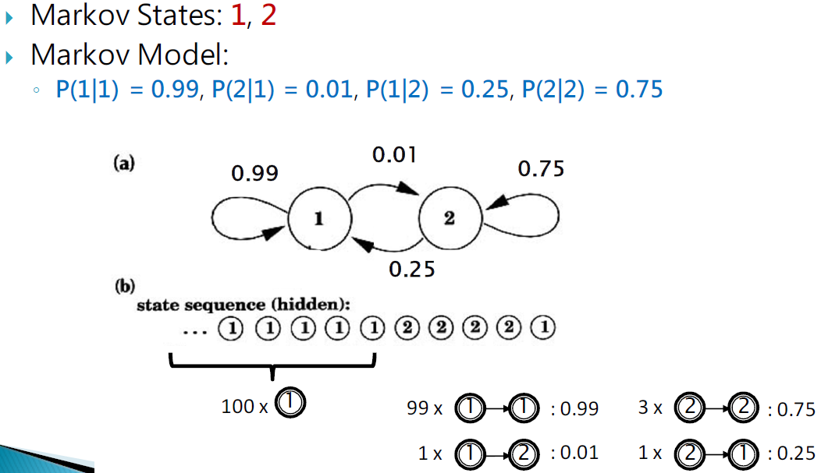
Markov model

Slide 49
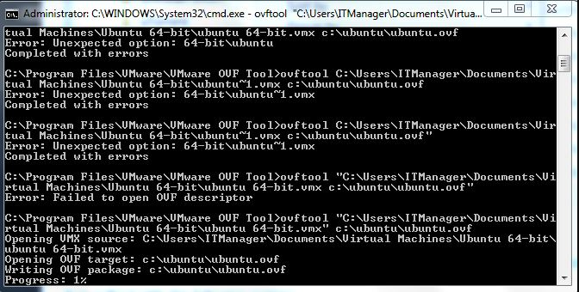
Exporting ovf from VMWare

